Slide 1
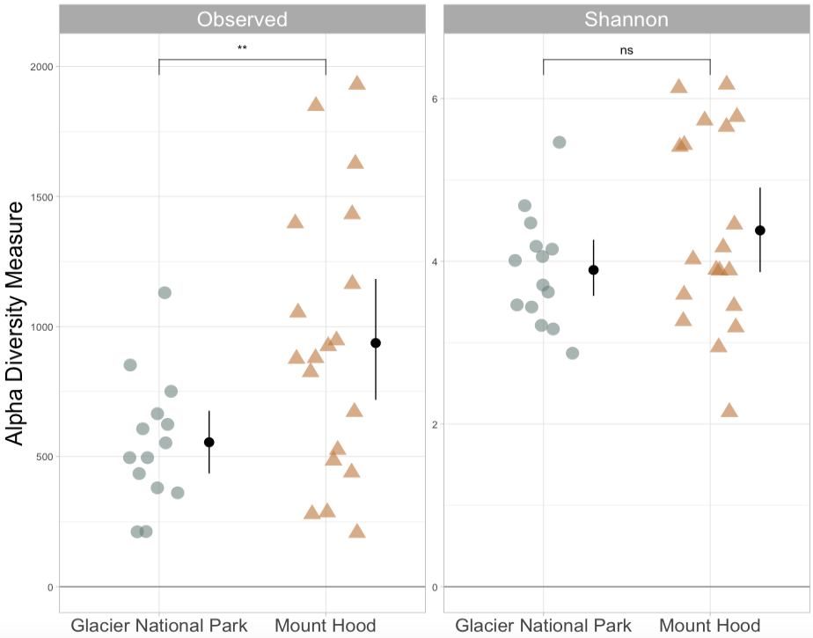
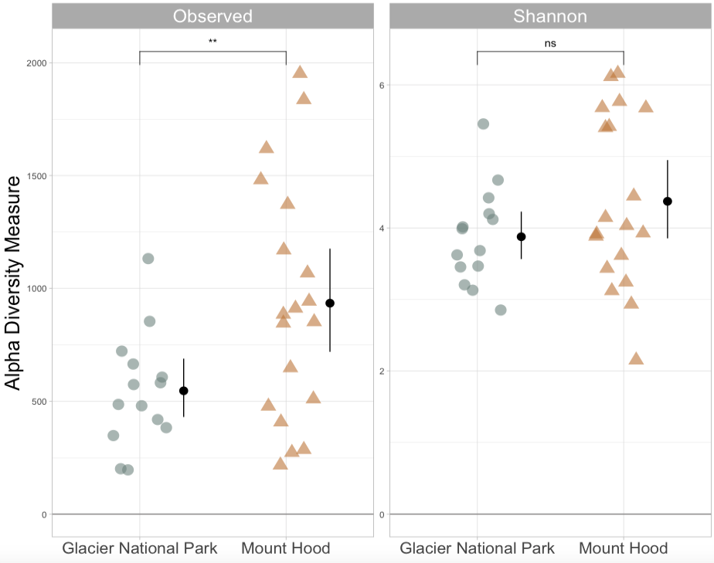
All 18S
Negligible difference in 18S files following rarefaction
18S
Nsamples (pre-filtering) - 55
Ntaxa (pre-filtering, no singletons) – 9,302
Nsamples (post-rarefaction) – 33 (19 MH, 14 GNP)
Ntaxa (post-rarefaction) – 7,921
Nsamples (pre-filtering) - 35
Ntaxa (pre-filtering, no singletons) – 8,708
Nsamples (post-rarefaction) - 33 (19 MH, 14 GNP)
Ntaxa (post-rarefaction) - 7627

Slide 2
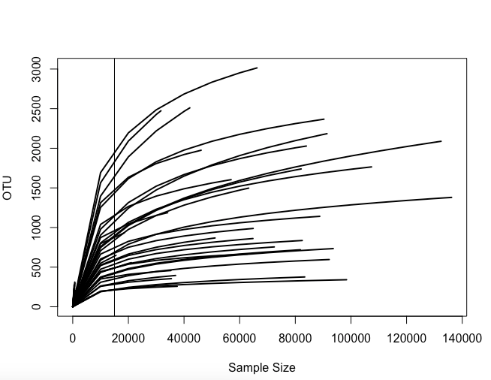
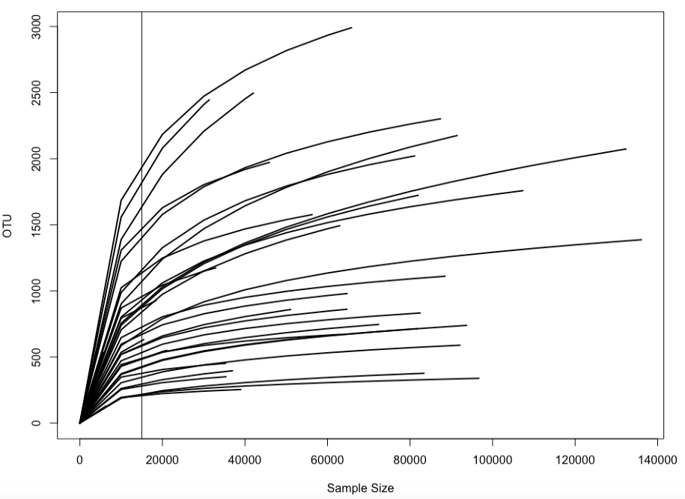
All 18S
Negligible difference in 18S files following rarefaction
18S

Slide 3
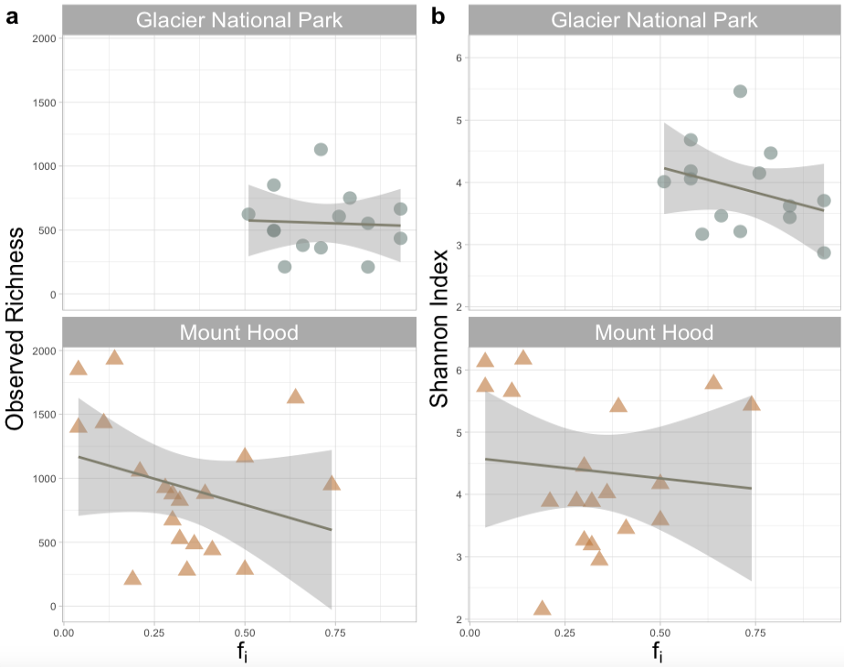
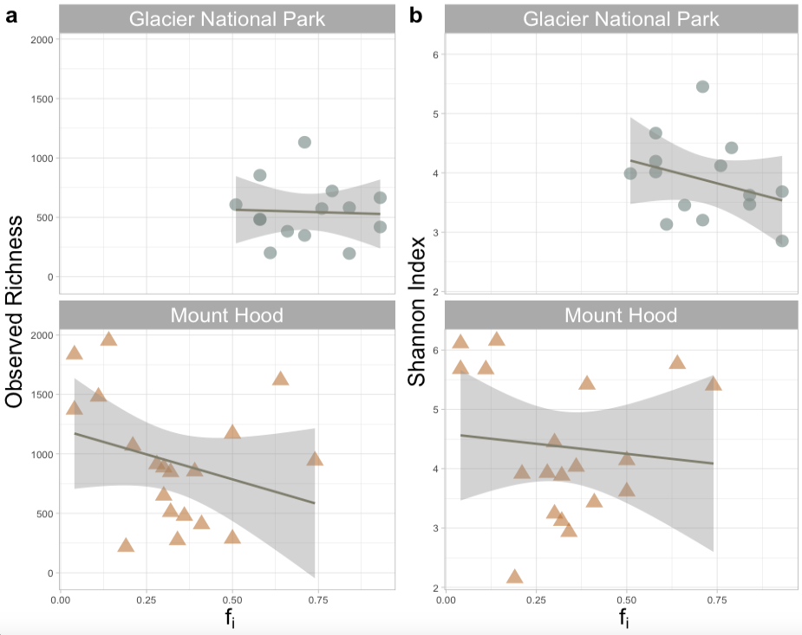
All 18S
Negligible difference in 18S files following rarefaction
18S

Slide 4
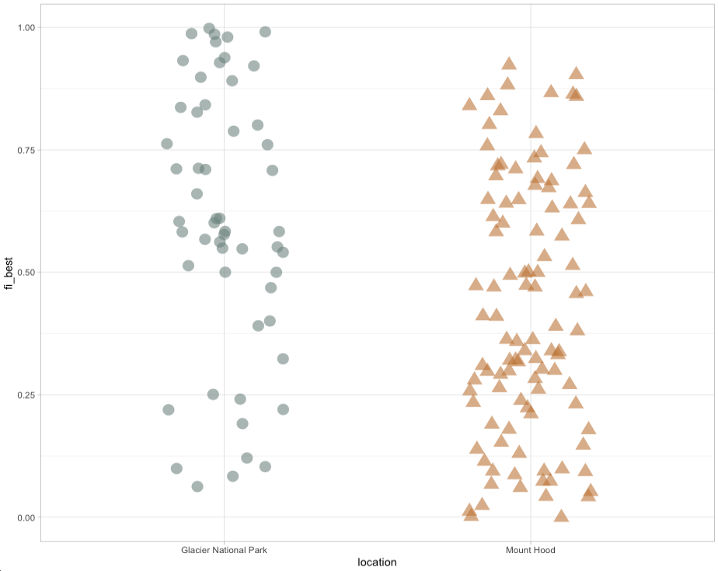
Our limited Fi (fraction contributions of glacier ice) is due to reduced biological samples

Slide 5
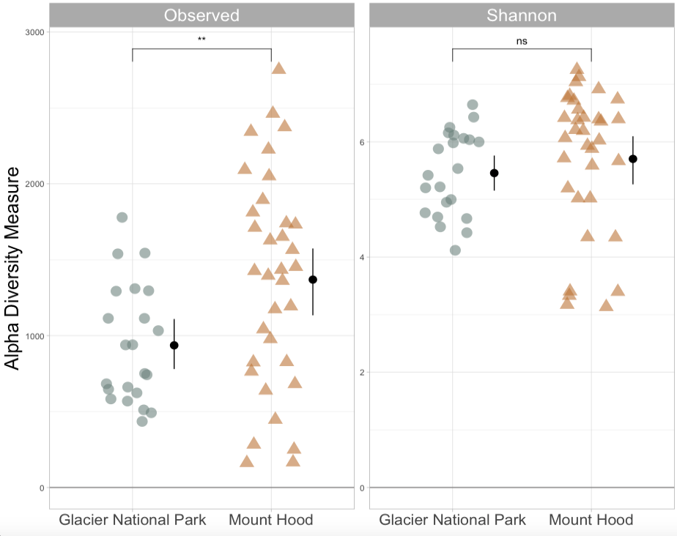
All 18S
16S = more samples, but negligible differences
16S
Nsamples (pre-filtering) - 55
Ntaxa (pre-filtering, no singletons) – 9,302
Nsamples (post-rarefaction) – 33 (19 MH, 14 GNP)
Ntaxa (post-rarefaction) – 7,921
Nsamples (pre-filtering) - 88
Ntaxa (pre-filtering, no singletons) – 21,062
Nsamples (post-rarefaction) - 56 (34 MH, 22 GNP)
Ntaxa (post-rarefaction) - 17565

Slide 6
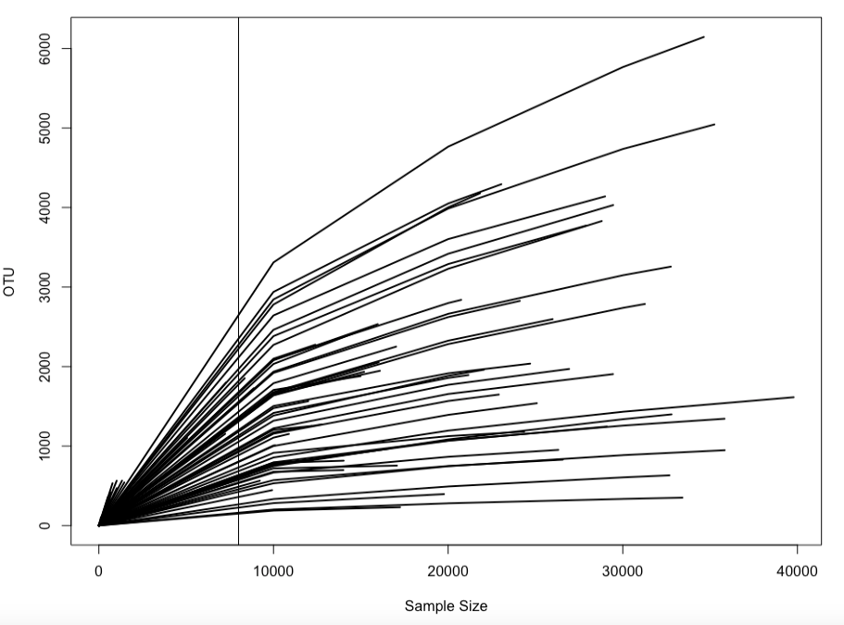
All 18S
Modify 16S rarefaction cutoff?
16S

Slide 7
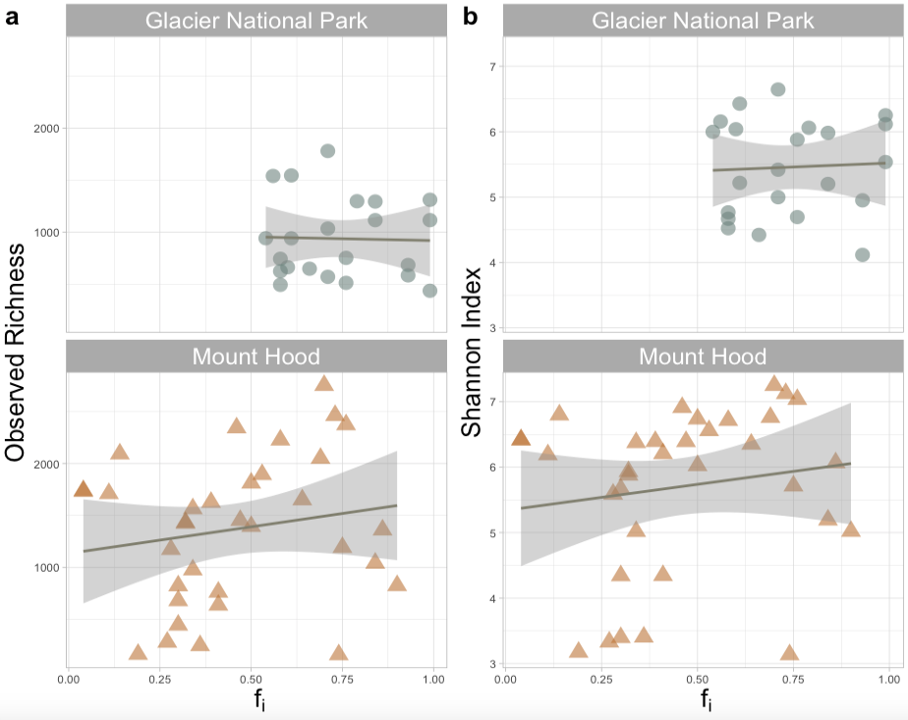
All 18S
16S = more samples, but negligible differences
16S

Slide 8
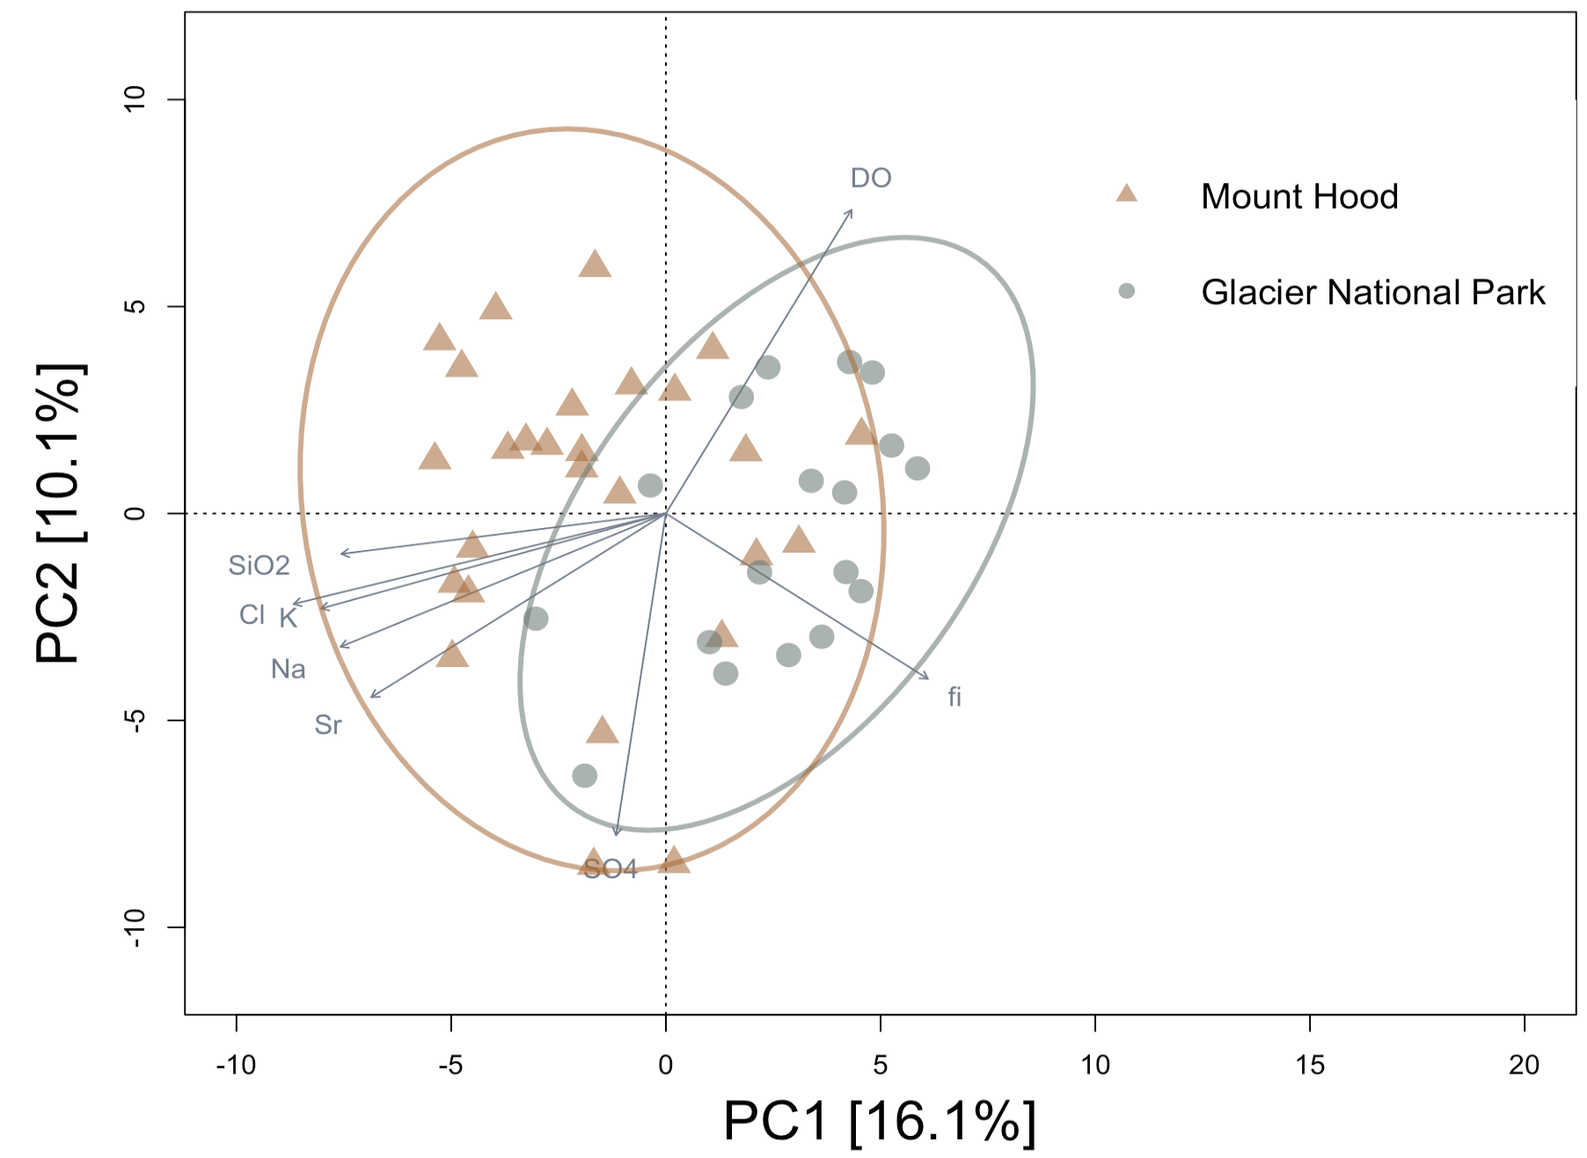
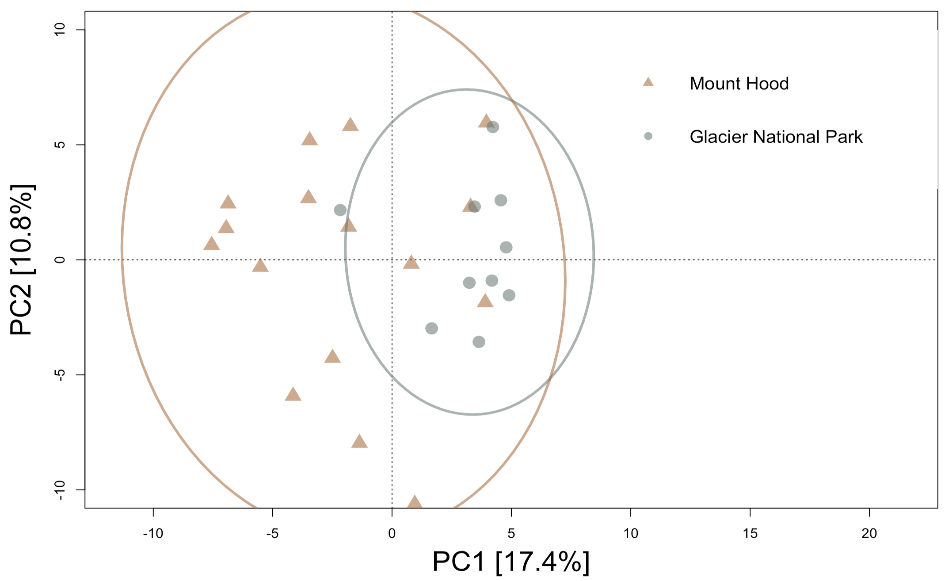
All 18S
No correlations between metadata and PCs for 18S
16S
Nsamples (pre-filtering, springs/streams only) - 45
Ntaxa (pre-filtering, no singletons) – 2,620
Nsamples (post-rarefaction) – 33 (19 MH, 14 GNP)
Ntaxa (post-vst) – 2,620
Nsamples (pre-filtering, springs/streams only) - 72
Ntaxa (pre-filtering, no singletons) – 3,587
Nsamples (post-rarefaction) - 45 (27 MH, 18 GNP)
Ntaxa (post-rarefaction) - 3,587

Slide 9
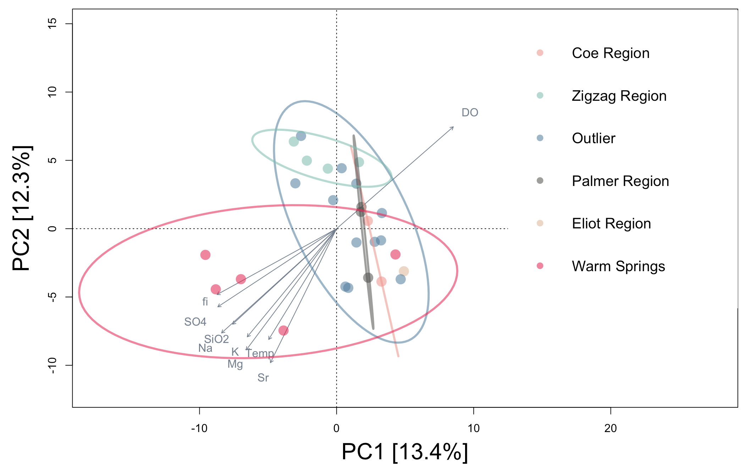
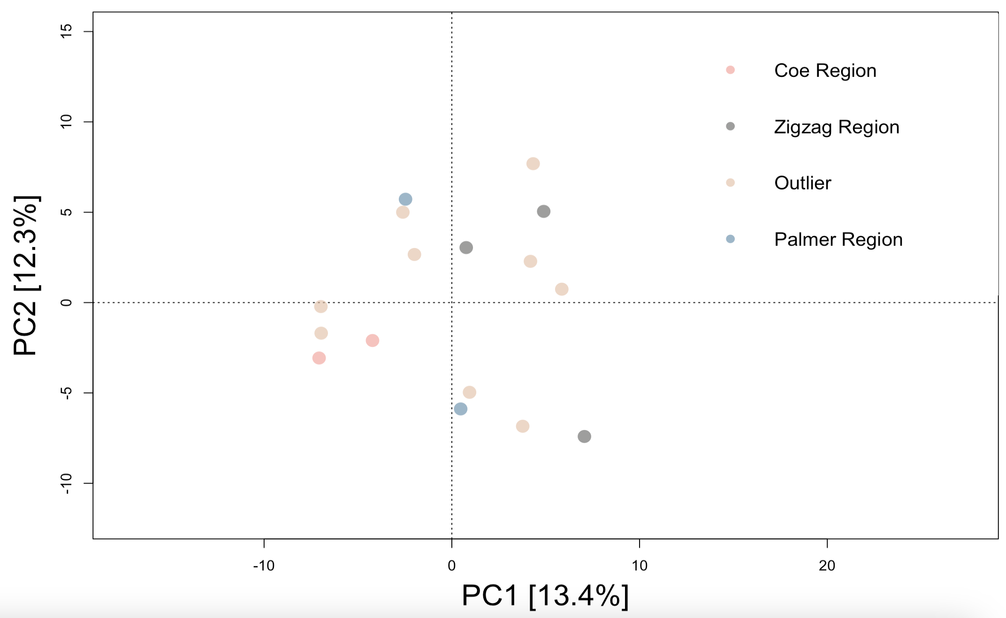
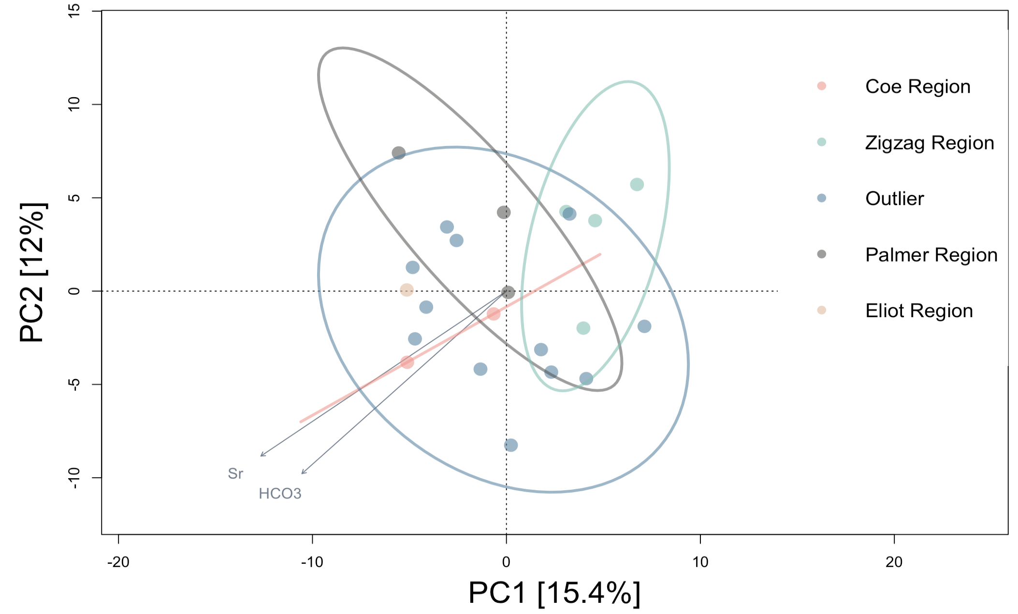
All 18S
16S
No Warm Springs

Slide 10
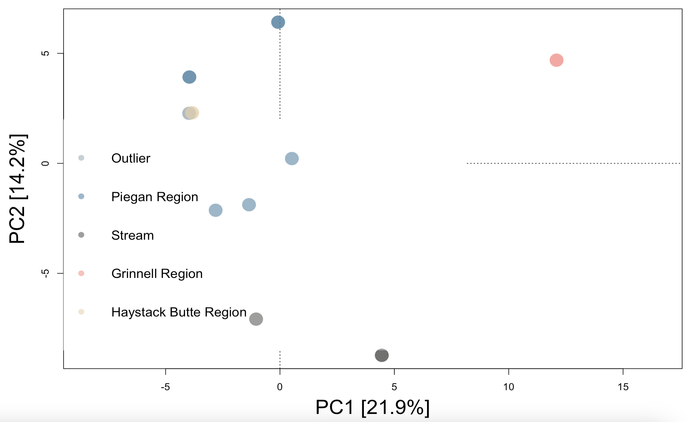
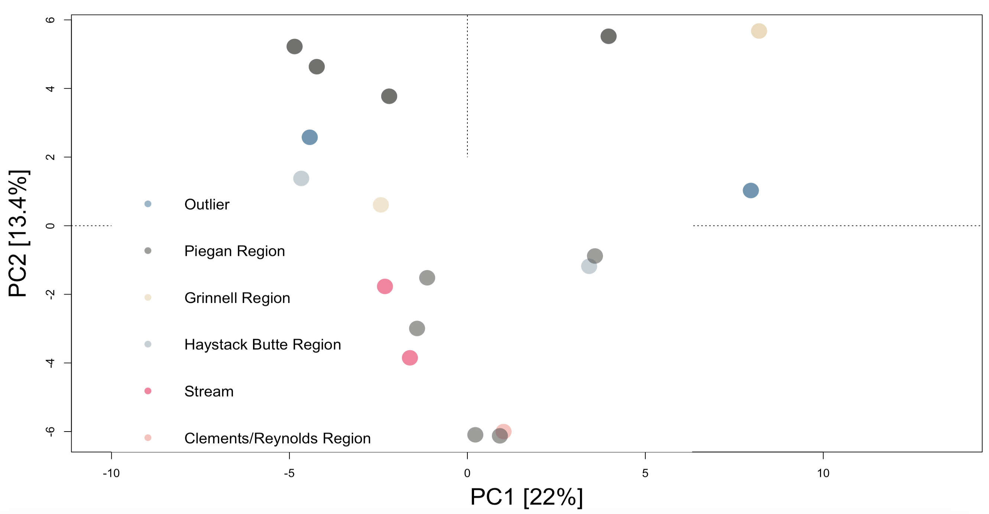
All 18S
16S

Slide 11
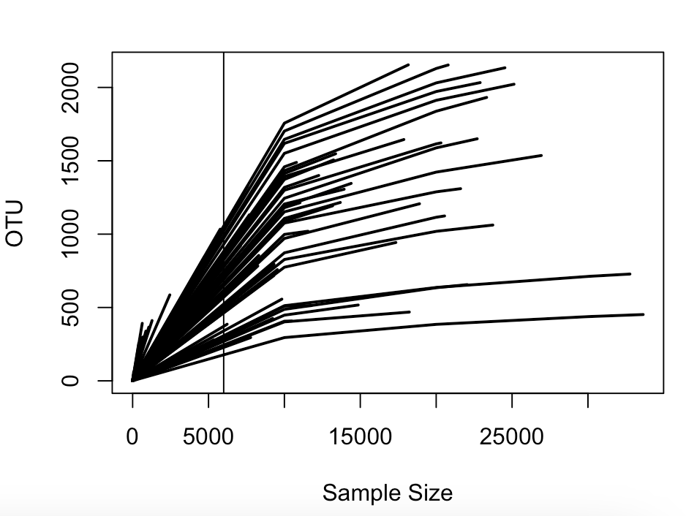
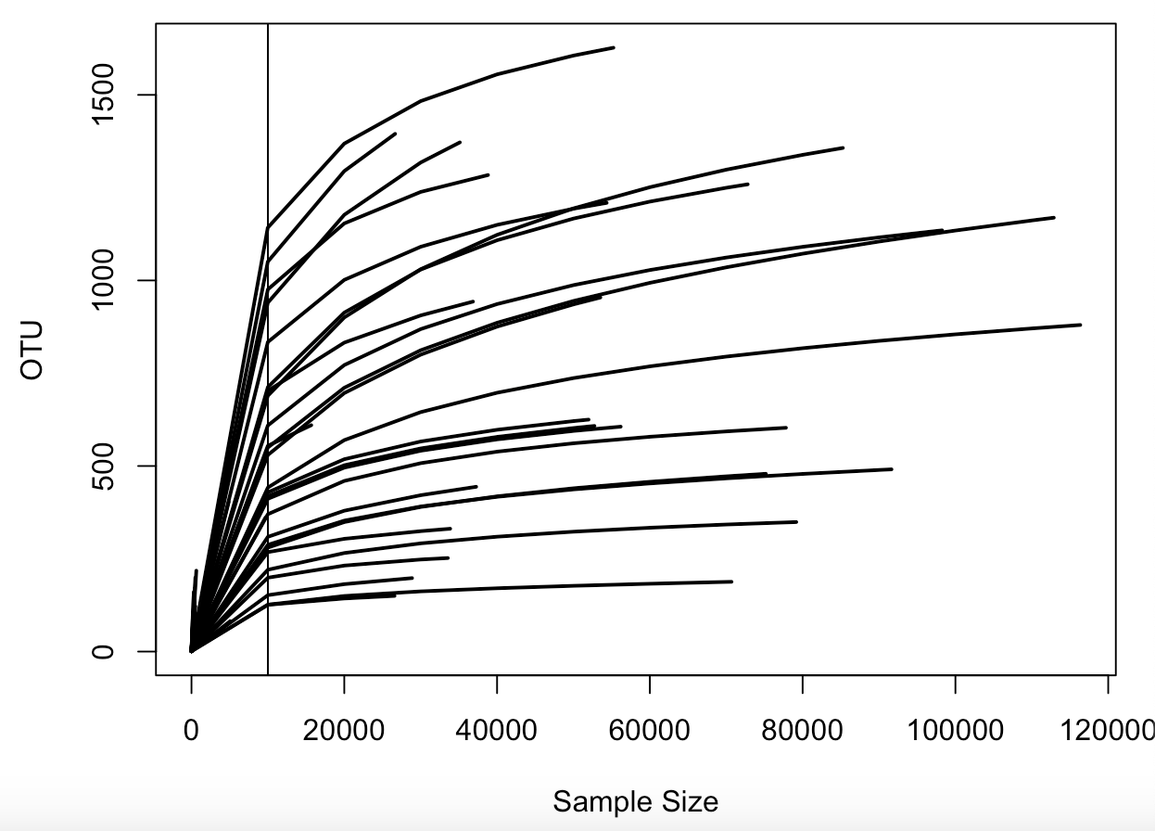
All 18S
Modify 16S rarefaction cutoff?
16S

Slide 12
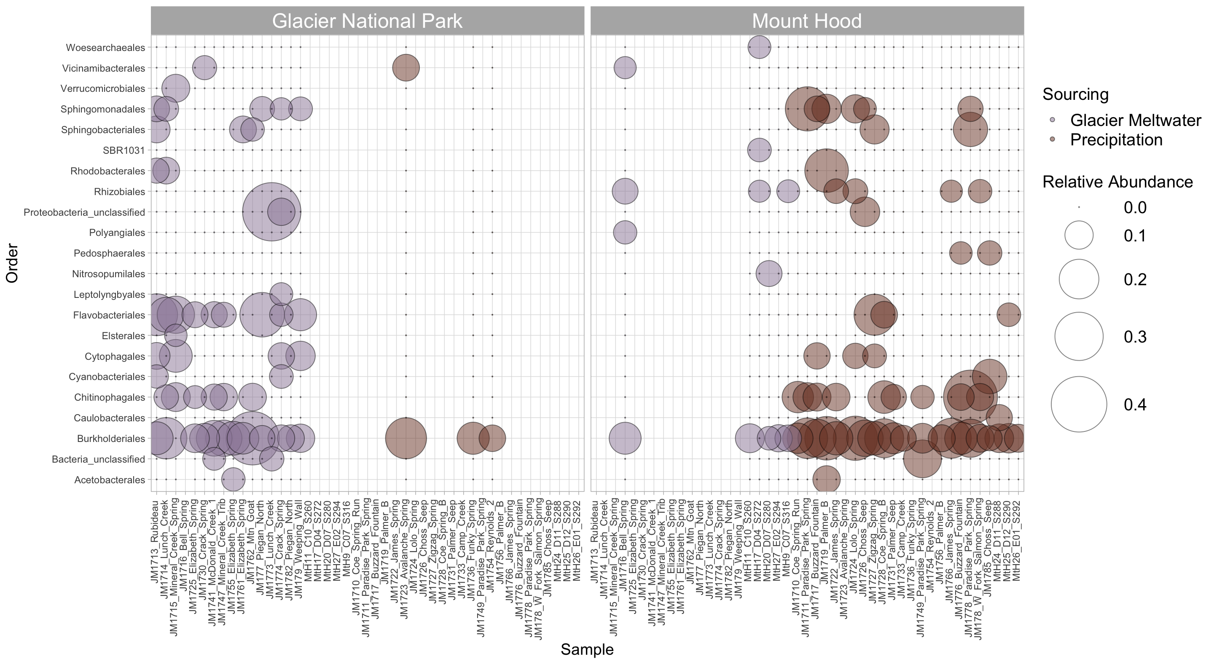
Fi spread = Limitation and skew toward assigning environmental variables as those most influential
[Samples]
[Samples]
16S

Slide 13
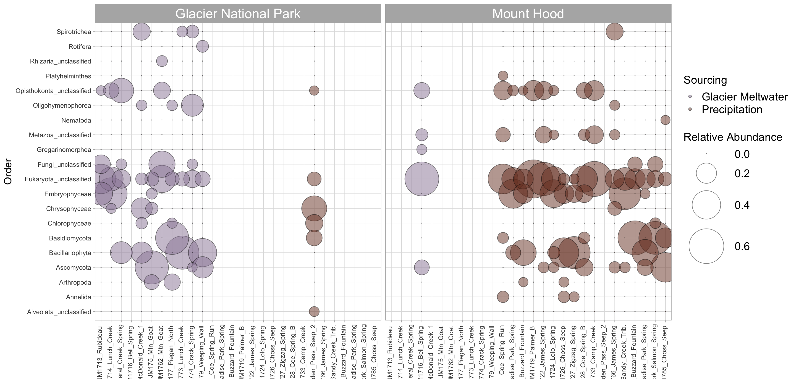
Fi spread = Limitation and skew toward assigning environmental variables as those most influential
[Samples]
[Samples]
All 18S

